Slide 1
DAA Assignment
-submitted to
Dr. Chandresh Kumar Maurya
-by
Manish Meena (181210028)
Deepika Kumari (181210019)

Slide 2
1. Divide & Conquer
Problem:
Given an array of numbers:
arr=[1, 20, 4, 0.5, -8, -22, 0.4, 66, 45, 0.01]
We have to find the maximum of this array

Slide 3
Figure 1.1
1 | 20 | 4 | 0.5 | -8 | -22 | 0.4 | 66 | 45 | 0.01
1 | 20 | 4 | 0.5 | -8
-22 | 0.4 | 66 | 45 | 0.01
1 | 20 | 4
0.5 | -8
-22 | 0.4 | 66
45 | 0.01
1 | 20
4
0.5
-8
22 | 0.4
66
45
0.01
1
20
4
0.5
-8
22
0.4
66
45
0.01
20
4
0.5
22
66
45
20
0.5
66
45
20
66
66

Slide 4
Figure 1.1 describes clearly how the problem is done.
In our approach of solving this problem, we will break this array
into 2 subarrays and further those subarrays again into 2-2
subarrays until the child subarrays has size of 1-2 elements as
we do in mergesort
Then we will find the maximum element in each
subarrays by just one comparison. Then all the maximum
elements from each subarrays are combined as per their just
parent array.
Now, we will find maximum element in this parent arrays and so
On.
This process is repeated recursively until we have only 1
Element left, i.e. the maximum element of the array.

Slide 5
2. Dynamic programming
Problem: Rod cutting problem
Given two arrays:
Size= [1, 2, 3, 4, 5, 6, 7, 8, 9, 10]
Price=[1, 5, 8, 9, 10, 17, 17, 20, 24, 30]
and a value n=5 (length of rod)
We have to cut the rod into pieces and sell them
in such a way as to earn maximum profit.

Slide 6
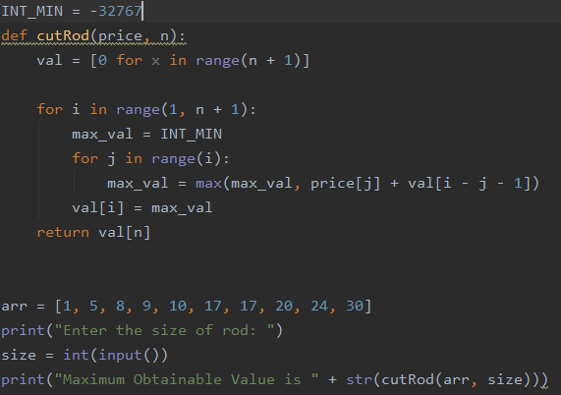
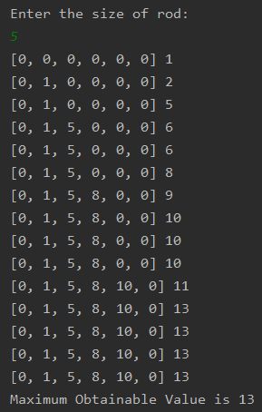
Input code:
Output:
Here in output, array val[] is an array that store the info that upto a given index “i”, maximum profit is val[i].
As the loop iterates from i=1 to n, we get the max profit from length equals to 1 to n. And at the end, we print the last element of array i.e. the maximum profit if length of rod given is “n”

Slide 7
3. Greedy Algorithm
Problem: Activity Selection problem
Given two arrays:
Start= [1, 3, 0, 5, 3, 5, 6, 8, 8, 2, 12]
Finish= [4, 5, 6, 7, 9, 9, 10, 11, 12, 14, 16]
These are the start and end time of a set of
activities.
We have to select the maximum number of
activities that can be performed by a single person,
assuming that a person can only work on a single
activity at a time.

Slide 8
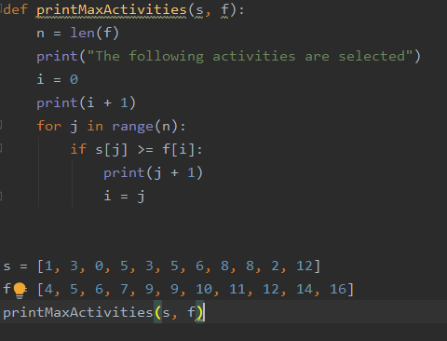
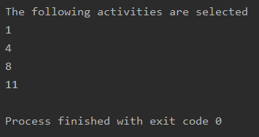
Input code:
Output:

Slide 9
It is assumed that the activities are already sorted according to their finish time.
The greedy choice is to always pick the next activity whose finish time is least among the remaining activities and the start time is more than or equal to the finish time of previously selected activity.
This is easily done by a condition statement in the loop.

Slide 10
4. Backtracking Algorithm
Problem: Sudoku 4x4 problem
Given a 2-d arrays:
grid = [[1, 0, 2, 0], [0, 4, 0, 3], [0, 2, 4, 0], [0, 0, 3, 0]]
Here ‘0’ means empty.
We have to replace all the ‘0’s in this array as
per sudoku rules.
Rule: no number should clash with same number in any
row or column or in its 2x2 subarray.

Slide 11
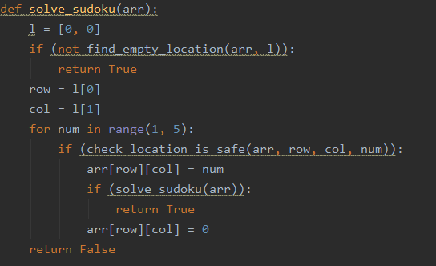
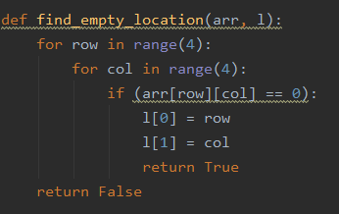
solve_sudoku function:
This is a method which is called in main to initialize the whole code.
First of all, it calls the find_empty_location function to find the first empty in the array and return the row and column index of empty position.

Slide 12
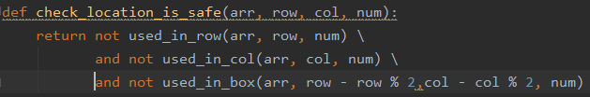
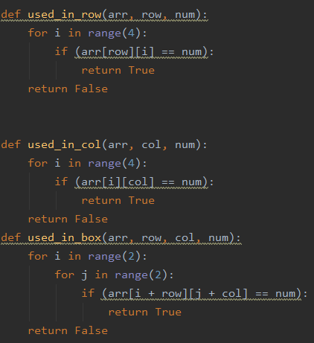
Now since we have the empty location, we put numbers from 1 to 4 in that position one by one and check the validity of that number by calling function check_location_is_safe.
This function checks in row, column and 2x2 subarray to check that there are no clashes of same number
This is done by calling there individual functions named used_in_row, used_in_column and used_in_box.

Slide 13
For any number, whose location is found safe, the number is placed in that position and recursively solve_sudoku function is again called to repeat the same procedure for next empty location until all the empty positions are filled.

Slide 14
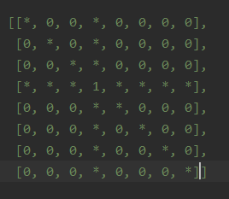
5. Branch and bound Algorithm
Problem: N-Queens problem
Given N=8 and a 2-d array of size NxN:
board = [[0, 0, 0, 0, 0, 0, 0, 0],
[0, 0, 0, 0, 0, 0, 0, 0],
[0, 0, 0, 0, 0, 0, 0, 0],
[0, 0, 0, 0, 0, 0, 0, 0],
[0, 0, 0, 0, 0, 0, 0, 0],
[0, 0, 0, 0, 0, 0, 0, 0],
[0, 0, 0, 0, 0, 0, 0, 0],
[0, 0, 0, 0, 0, 0, 0, 0],]
Here ‘0’ means empty.
We have to fill this array with maximum of chess queens such that they do not collide
with each other as per chess rules.
Rule: If there is a queen at any position say board[i][j] then , there would be no queen
in ith row or in jth column or also in the diagonals both slach as well as backslash
orientation. As shown in figure, if 1 is queen position then “*” represent the affected area

Slide 15
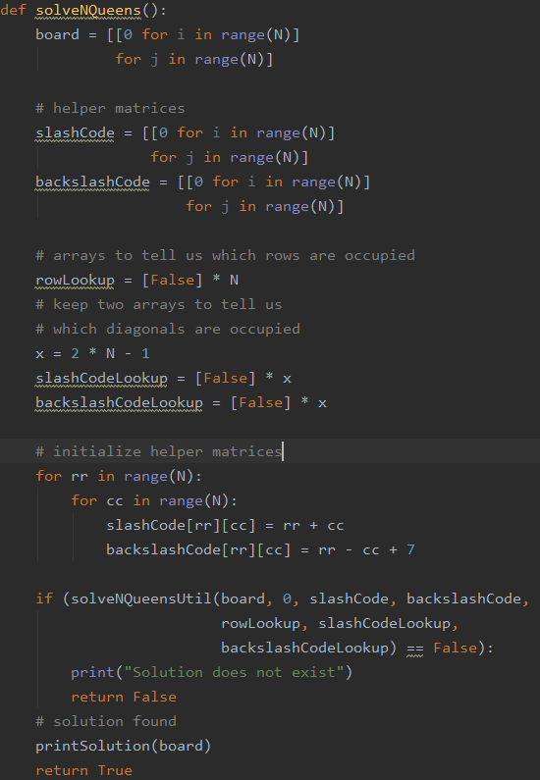
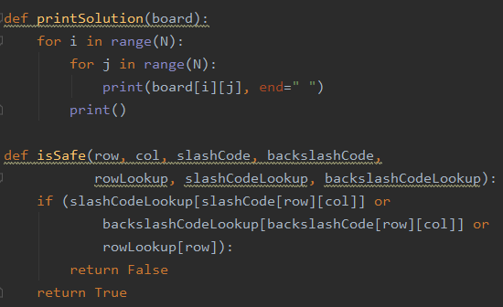
We have made 3, 2-d arrays :
To represent board,
To represent slash affected area,
to represent backslash affected area
And an boolean array to check if the row has a queen or not.
By a function named solveNQueensUtil, we check if the given row has a queen or not and if there is no queen, we put a queen at first safe column.
This procedure is repeated until all the rows have a queen by recusively calling function solveNQueensUtil

Slide 16
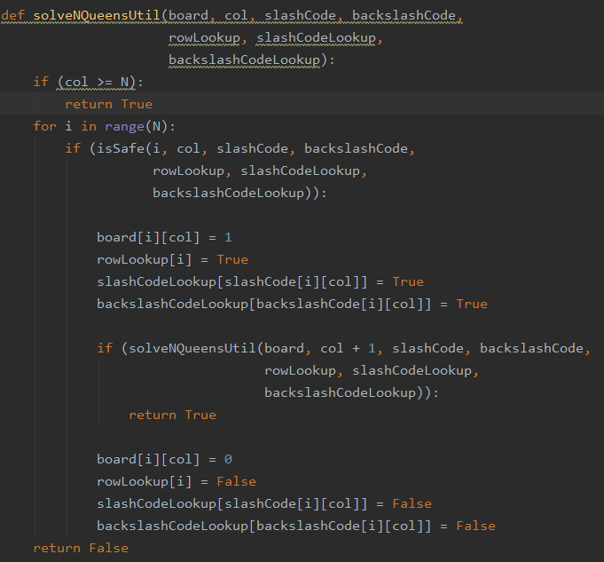
isSafe function is to check the safe position

Slide 17
Thanks

